Slide 1
Introduction to AI in Health
Matt Engelhard, Department of Biostatistics & Bioinformatics
Notes:
Hi Everyone
I’m Matt Engelhard – I’m an assistant professor here in the Department of Biostatistics & Bioinformatics
Work to develop machine learning methods for clinical data
And I’m delighted to have this important, and I think very timely, opportunity to talk to you about what these technologies are, and why it’s important to us working in healthcare

Slide 2
10,000-foot view of machine learning in 2024
Computer vision (self-driving)
Natural language processing (NLP) (ChatGPT)
Reinforcement learning (AlphaGo)
Each of these has high clinical relevance
ML for large, high-dimensional biomedical data
electronic health record
-omics
digital health
Notes:
3 pillars of machine learning
First is computer vision. This is the tech that facilitates self-driving, and more importantly allows my daughter to use my own phone to make me look like a cat
We have natural language processing, or NLP – this is the tech behind chatGPT… will it save the world, will it destroy the world – I’m not sure, but I do think the underlying tech will be quite useful in clinical medicine
Finally, we have reinforcement learning – this is the technology behind the fact that magnus Carlson, the highest ranked chess player in the world, can no longer beat the chess app built into every airplane headrest
Fortunately for us, each of these has extremely high clinical relevance
The first is useful in clinical medicine already
The second is now coming into its prime and outperforming human experts
The third is not quite ready for prime-time in most cases, but disruption in clinical medicine is on the horizon
On top of that, there’s been rapid (athough admittedly less publicized) progress in use of ML to understand and make predictions from large-scale clinical and biomedical data…
So, let’s look at each of these 3 pillars in turn.

Slide 3
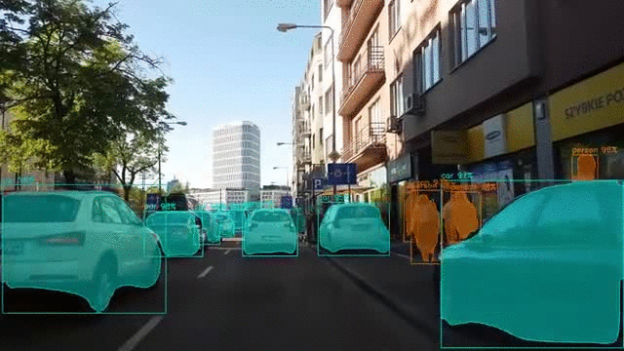
Computer Vision: Real-Time Object Detection & Segmentation
Notes:
We’ll start with our first pillar: computer vision
What’s happening here?
We have a system that, in real time, is recognizing … and identifying their contours
The first – identifying distinct objects – we call object detection
The second – precisely outlining their boundaries – we call segmentation
You’ve probably seen something like this on youtube – systems like this are an important component of self-driving tech
The same kind of models that can do this… can do that…

Slide 4
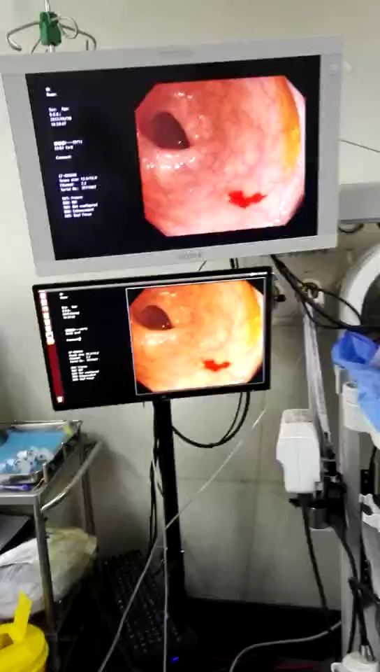
Real-time polyp detection: a second set of eyes during colonoscopy
Notes:
Describe

Slide 5
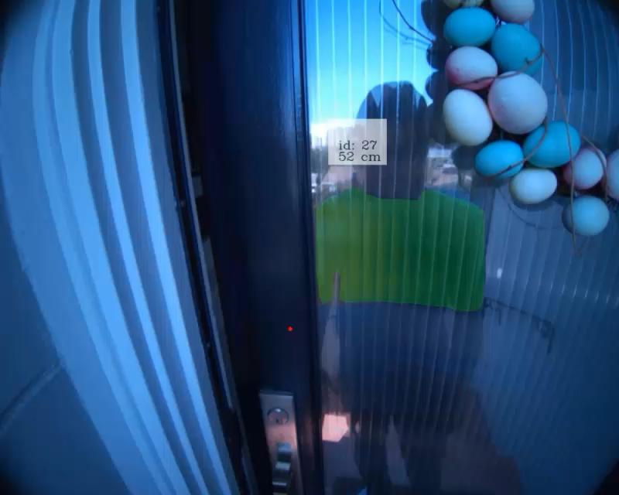
Segment Anything (even unfamiliar objects)
Kirillov, Alexander, et al. "Segment anything." arXiv preprint arXiv:2304.02643 (2023).
https://segment-anything.com
Notes:
Now, the model a showed you a moment ago is actually a few years out of date.
Over the past few years we’ve seen
- better performance
- more precise boundaries
- (most importantly) better ”zero-shot generalization”, in other words to unknown objects and settings

Slide 6
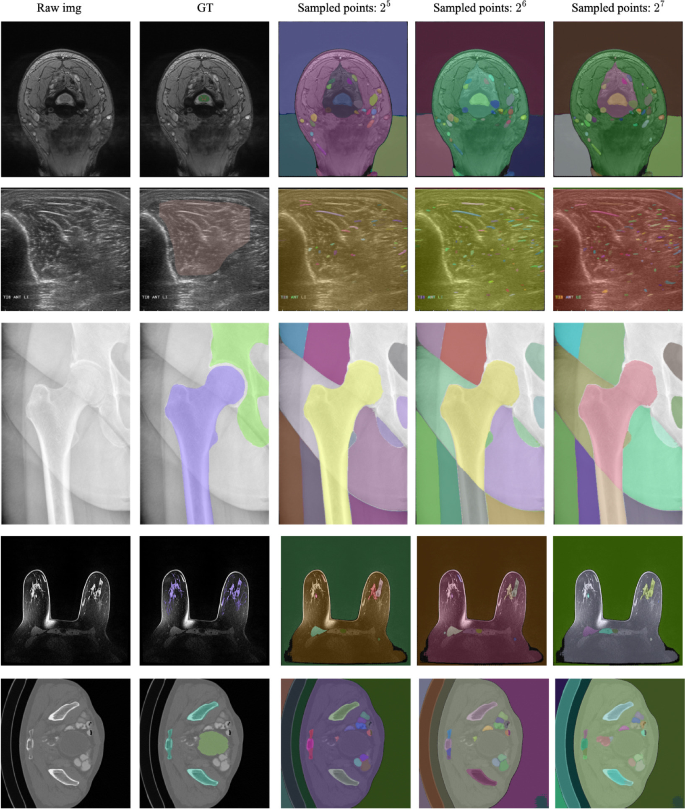
Segment Everything in Medical Images
Mazurowski, Maciej A., et al. "Segment anything model for medical image analysis: an experimental study." Medical Image Analysis 89 (2023): 102918.
Notes:
The segment anything approach does in fact extend to medical images, as shown by AI Health’s own Maciej Mazurowski
Though they do note that performance is highly variable depending on the specific task
For example performing quite well for hip X-ray, as shown in the middle here, but poorly for spine MRI
ABSTRACT: Training segmentation models for medical images continues to be challenging due to the limited availability of data annotations. Segment Anything Model (SAM) is a foundation model trained on over 1 billion annotations, predominantly for natural images, that is intended to segment user-defined objects of interest in an interactive manner. While the model performance on natural images is impressive, medical image domains pose their own set of challenges. Here, we perform an extensive evaluation of SAM’s ability to segment medical images on a collection of 19 medical imaging datasets from various modalities and anatomies. In our experiments, we generated point and box prompts for SAM using a standard method that simulates interactive segmentation. We report the following findings: (1) SAM’s performance based on single prompts highly varies depending on the dataset and the task, from IoU=0.1135 for spine MRI to IoU=0.8650 for hip X-ray. (2) Segmentation performance appears to be better for well-circumscribed objects with prompts with less ambiguity such as the segmentation of organs in computed tomography and poorer in various other scenarios such as the segmentation of brain tumors. (3) SAM performs notably better with box prompts than with point prompts. (4) SAM outperforms similar methods RITM, SimpleClick, and FocalClick in almost all single-point prompt settings. (5) When multiple-point prompts are provided iteratively, SAM’s performance generally improves only slightly while other methods’ performance improves to the level that surpasses SAM’s point-based performance. We also provide several illustrations for SAM’s performance on all tested datasets, iterative segmentation, and SAM’s behavior given prompt ambiguity. We conclude that SAM shows impressive zero-shot segmentation performance for certain medical imaging datasets, but moderate to poor performance for others. SAM has the potential to make a significant impact in automated medical image segmentation in medical imaging, but appropriate care needs to be applied when using it. Code for evaluation SAM is made publicly available at https://github.com/mazurowski-lab/segment-anything-medical-evaluation.

Slide 7
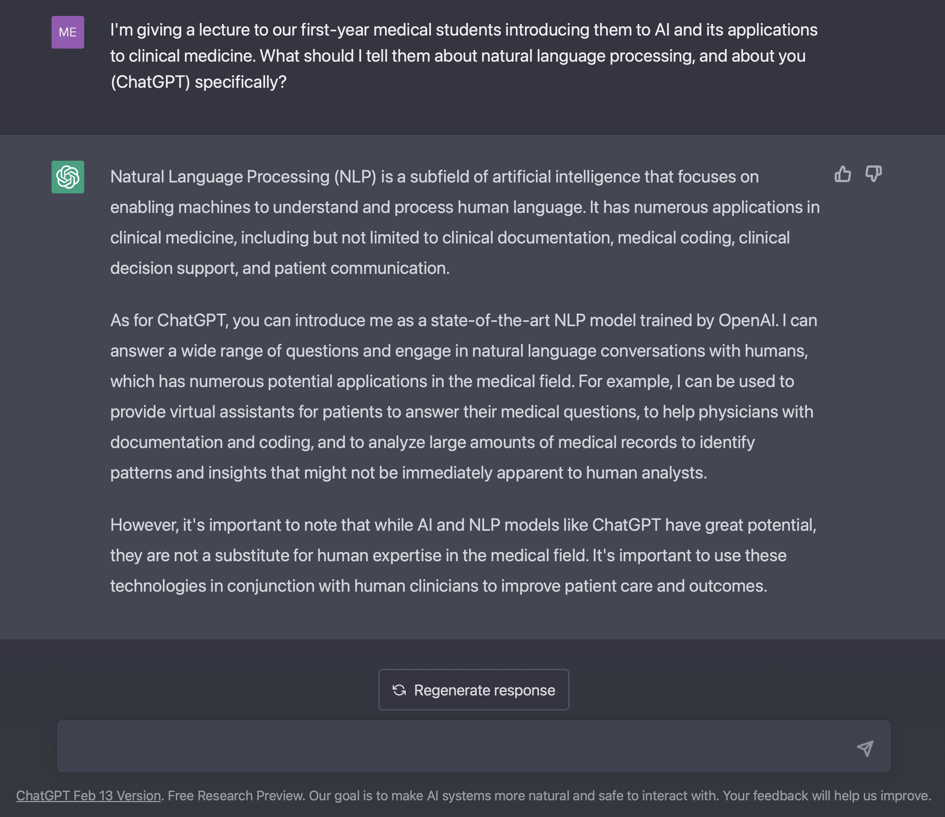
NLP: Text Generation
Notes:
2nd pillar: natural language processing
What can NLP do?
Well, many of you have likely already explored it yourself
Now, I would never use chatGPT to write a lecture for this group – you’re too important
But I did use it to help me design my lecture for the first-year medical students
And here’s what it told me…
And if I had asked it for more specific, detailed suggestions, it would have provided them
As ChatGPT notes, it’s not a substitute for human expertise
But the system is in fact quite humble, and similar models (e.g. Google’s MedPalm2) show quite impressive performance on questions from the US Medical Licensing Exam

Slide 8
Text Generation via GPT-3 (ChatGPT precursor)
SYSTEM PROMPT (HUMAN-WRITTEN)
A train carriage containing controlled nuclear materials was stolen in Cincinnati today. Its whereabouts are unknown.
MODEL COMPLETION (MACHINE-WRITTEN, FIRST TRY)
The incident occurred on the downtown train line, which runs from Covington and Ashland stations.
In an email to Ohio news outlets, the U.S. Department of Energy said it is working with the Federal Railroad Administration to find the thief.
“The theft of this nuclear material will have significant negative consequences on public and environmental health, our workforce and the economy of our nation,” said Tom Hicks, the U.S. Energy Secretary, in a statement. “Our top priority is to secure the theft and ensure it doesn’t happen again.”
The stolen material was taken from the University of Cincinnati’s Research Triangle Park nuclear research site, according to a news release from Department officials.
The Nuclear Regulatory Commission did not immediately release any information.
According to the release, the U.S. Department of Energy’s Office of Nuclear Material Safety and Security is leading that team’s investigation.
“The safety of people, the environment and the nation’s nuclear stockpile is our highest priority,” Hicks said. “We will get to the bottom of this and make no excuses.
“Better Language Models and Their Implications”
2/14/19
OpenAI
Notes:
Now, chatGPT hype is recent, but the writing has been on the wall since about 2018-2019
This is when we got GPT-3, precursor to chatGPT…
- A Generative model based on transformer architecture and trained on 8 million webpages
- around this time, it could write perfect looking stories
- exceed human performance on question answering benchmarks, in which the system answers a question based on a given paragraph of text
Work since then has focused on
(a) Further scaling up the model
(b) Aligning models with human preferences using a process called reinforcement learning from human feedback
Work to align models continues

Slide 9
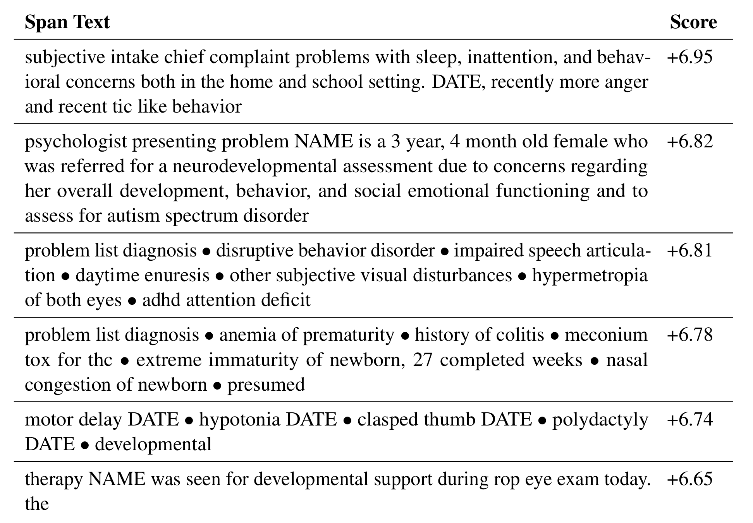
Natural Language Processing: Find Predictive Text in Notes
Passage (from note) | Change in predicted autism dx log-odds
Developmental and behavioral concerns are highly predictive
Premature birth and perinatal complications are also highly predictive
Subramanian V, Engelhard MM, Berchuck SI, Chen L, Carin L. SpanPredict: Extraction of Predictive Document Spans with Neural Attention. Submitted to NAACL.
Notes:
What can NLP do in medicine?
Well, I’ll let you use your imagination – summarizing medical knowledge, extracting specific information from patient charts, creating template responses for mychart
But I want to point out one application from our work…
We used natural language processing to do something that no human can do
Namely, read every single clinical in every single child’s chart
And identify types of note content early in life that are associated with later autism diagnosis

Slide 10

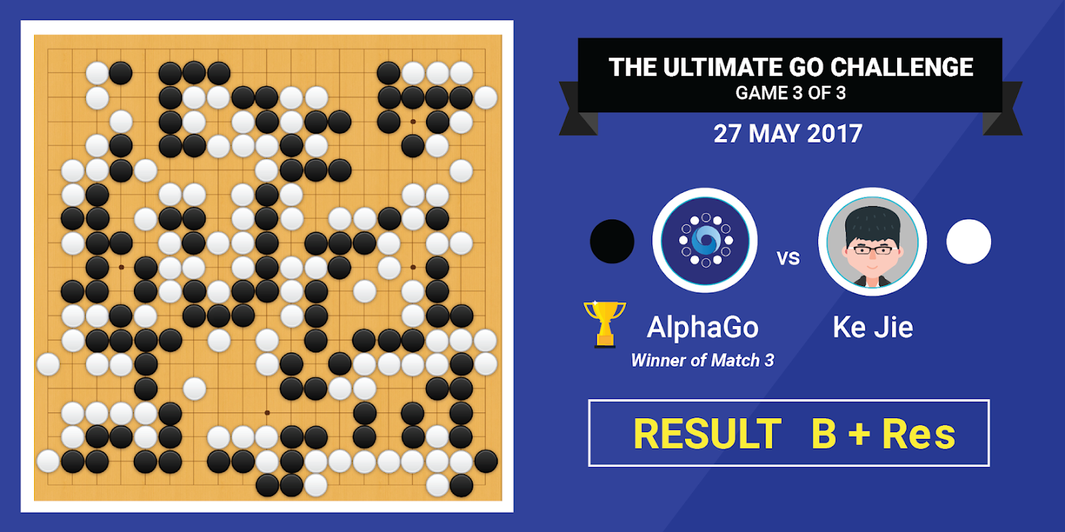
Reinforcement Learning: goal-directed sequential decision-making
Notes:
On to Pillar 3: reinforcement learning
Now here we have a stick figure
Whose control over his motor function is tenuous at best
And, much like me on the average day, he’s actually running late to pick up his kid from daycare
So, this is an agent
Who’s trying to achieve a specific goal – namely, to get to the daycare on time
And he has some actions available to him, some of which help him reach the goal (e.g. stepping forward)
And others of which don’t (e.g. pumping his fist repeatedly)
He’s trying to figure out which actions are going to get him there.
It’s the same with chess
Goal-directed sequential decision-making
What moves help alphaGo win the game?
What moves hurt it?

Slide 11
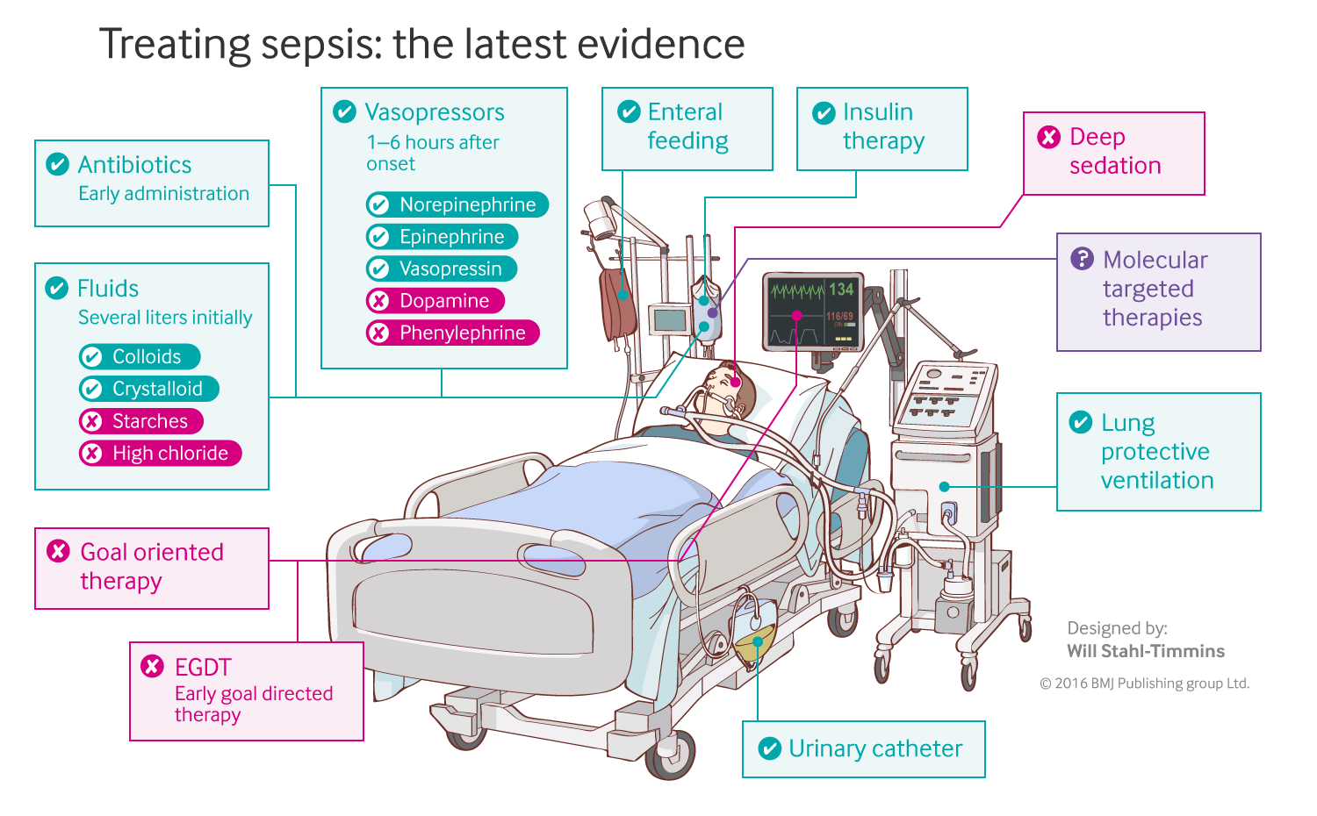
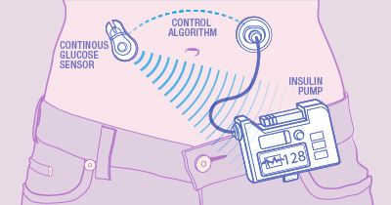
Reinforcement Learning in Medicine
Closed-loop blood glucose control
(“artificial pancreas”)
Fluid and vasopressor administration
for sepsis treatment
https://www.mayo.edu/research/labs/artificial-pancreas/overview
Gotts JE, Matthay MA. Sepsis: pathophysiology and clinical management. bmj. 2016 May 23;353(i1585).
Notes:
How is this relevant to clinical medicine?
Well, goal-directed decision-making is everywhere!
That same tech is helping us understand how to design an artificial pancreas that maintains normoglycemia more effectively than a person can
And can help us optimize certain types of sequential decision-making problems, such as fluid and vasopressor administration in sepsis management
In each case, we have an agent
Who’s trying to achieve a specific goal
It has some available actions, some of which help
And some of which don’t
Trying to figure out which actions get us to normoglycemia
Or to surviving sepsis

Slide 12
All of these have, at their core, a predictive model
y, associated value or label
x, data/features for a subject or patient
End goal: predict y from x
Notes:
But now let’s step back.
We have some very sophisticated systems, no doubt
But at the heart of all of them is this: a predictive model.
You can think of it as an equation – an algorithm – and in practice it’s implemented as a computer program – it’s going to take some data, let’s say x – process it in some way -- and then make a prediction about some associated value y -- its prediction about y is informed by the data x
The thing that accepts features x, and spits out a prediction y – that’s the machine in machine learning.
The machine could be a computer, a person with a calculator, whatever
But whatever it is, it needs to learn, from data, how the x’s relate to the y’s – so it can make the best predictions possible.
Let’s see some more meaningful examples.

Slide 13
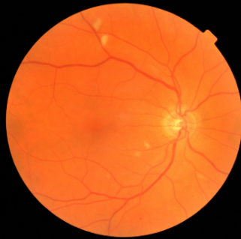
Computer Vision: prediction via convolutional neural network
y, referrable diabetic retinopathy
x, retinal image
End goal: predict y from x
Notes:
In computer vision, x is an image – a grid of pixels – and y is an associated label
For example, we’ve seen computer vision models that are better than experts
At taking a fundoscopic image like the one shown here
And predicting whether that patient has referrable diabetic retinopathy

Slide 14
Natural Language Processing: prediction via stacked attention networks
y, autism risk
x, clinical note
End goal: predict y from x
Notes:
Let’s move on to NLP – again, we have an x – a clinical note
We’re able to convert that note to a sequence of vectors, where each vector corresponds to a word in the note encodes different aspects of that word’s meaning
- this process of course goes a bit beyond what we’ll discuss today
- But at this point, what’s important is that again, we have a machine that takes this note – a numeric representation of it -- and spits out an associated prediction
In my research, as I mentioned, the prediction might be: whether the note is associated with later development of autism

Slide 15
Natural Language Processing: prediction via stacked attention networks
y, next word
x, conversation history
End goal: predict y from x
Notes:
Now, what about the systems we’re seeing today?
Does the paradigm I’ve described still fit?

Slide 16
Reinforcement Learning: state to action predictions via dense neural network
y, next move
x, Go board state
End goal: predict y from x
Notes:
In reinforcement learning – here let’s go back to a model that’s learned to play Go
x is the state of the board
And y is the best move to take – the one that the model believes is most likely to lead it to victory
Going back to our stick figure, if our model has learned well, it’s prediction y should be something like “step forward”
And not “pump your fist in the air repeatedly”
And in the sepsis management setting, the “state of the board” – x -- is the patient’s physiologic status.

Slide 17
APACHE III: A model for predicting ICU mortality
WBC Count
Respiratory Rate
Creatinine
Mean BP
Hematocrit
Pulse Rate
Temperature
Survival
Age
y, associated value or label
x, data/features for a subject or patient
End goal: predict odds of hospital mortality
Notes:
Now In medicine, often x is a fairly simple set of features
Models that deal effectively with highly complex data, like images – those are fairly new
But predictive models are NOT new, AT ALL, in medicine
Think cardiology, Framingham, pooled cohort equations, etc
We have APACHE III, for instance – APACHE stands for ACUTE PHYSIOLOGY AND CHRONIC HEALTH EVALUATION
This is a predictive model – the original version dates back to the 70s -- that takes a limited set of clinical variables, collected on ICU admission, and makes a mortality prediction

Slide 18
Traditional models (e.g. logistic regression) tend to work well for data like this.
Age
WBC Count
Respiratory Rate
Creatinine
Mean BP
Hematocrit
Pulse Rate
Temperature
Survival
y, associated value or label
x, data/features for a subject or patient
End goal: predict odds of hospital mortality
Notes:
When you have data like these – tabular, clinical data –
Typically you don’t need a super complex model – a deep neural network, let’s say
Don’t want to make these things more complicated then necessary
we should use the simplest and most interpretable model that will do the job
I’m not 100% sure but would guess that APACHE is a logistic regression model

Slide 19
As the complexity of the underlying data increases, so too does the probable value added by machine learning
image analysis
(radiology, pathology)
fusion of multiple modalities
McKinney et al.
natural language processing (clinical notes)
Craik et al.
clinical and digital health time series
Christodoulou et al.
value added by machine learning
structured EHR or registry data
S. Huang et al.
curated clinical datasets
K. Huang et al.
Khera et al.
data complexity
Simple models based on clinical variables remain highly relevant
*Use the simplest model that gets the job done*
Notes:
On the other hand, computer vision simply cannot be solved with logistic regression. It won’t work.
Geoff Hinton said something like this: if there were a simple set of rules that could be applied to figure out whether an image contains a dog, for instance – or whether a fundoscopic image represents referrable diabetic retinopathy – we would have figured it out a long time ago. It’s just the case that those problems require very complex models. The same is true with text, and with lots of other data increasingly common in medicine
What we see, empirically, is something like what’s described here

Slide 20
What do we mean by complex data?
And why are machine learning methods so helpful when modeling complex data?
Notes:
Though big data is helpful to make it work…

Slide 21
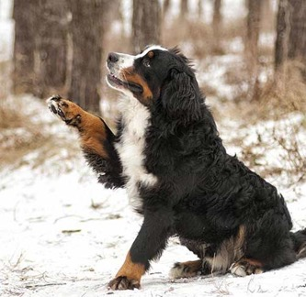
Predictions from complex data: What does a single feature (e.g. pixel) tell us?
y, associated value or label
x, data/features for a subject or patient
End goal: predict y from x
Notes:
Let’s contrast that with image processing
Want a model that identifies “Bernese Mountain dog”
What are the predictors here?
First: a single pixel has little to do with the outcome
Second: pixels are arranged in a meaningful way – not true of the previous model

Slide 22

Classification of Medical Images: What does a single pixel tell us?
y, associated value or label
x, data/features for a subject or patient
End goal: predict y from x
Notes:
The same is true for medical images
Thinking about this fundoscopic image, does it really matter whether a specific pixel is light versus dark?
What matters are the pixels in relation to one another.
Together they form vessels, suggest exudates, comprise the optic disk – but in isolation, they are near meaningless

Slide 23
What do we mean by complex data?
Less about big data (i.e. large N)
More about high-dimensional data (i.e. large M)
Data with underlying temporal, sequential, or spatial structure
(i.e. dependent data that are indexed by a second set)
Applications where feature engineering was previously required
Notes:
Though big data is helpful to make it work…

Slide 24
Predictions from complex data: Deep learning builds a hierarchy of features.
low-level motifs
high-level motifs
dog
label
pixels
End goal: predict dog from pixels
Notes:
In APACHE we can go straight from predictors to label
here we have to build up our understanding of the image bit by bit.
pixels… → lines, arcs, textures
lines and arcs → shapes, contours
Shapes, contours → paw, ear, eye
Paw, ear, eye → dog
All these patterns – we call them motifs
And they are arranged in a hierarchy
#Prediction at each level is easy
#We break up an incredibly complex tasks into a sequence of much simpler tasks

Slide 25
Predictions from complex data: Deep learning builds a hierarchy of features.
high-level motifs are
specific arrangements
of low-level motifs
low-level motifs
high-level motifs
dog
edges
shapes
textures
eyes
ears
paws
label
pixels
End goal: predict dog from pixels
Notes:
Hinton:
“If there were simple rules”… it wouldn’t have taken us until 2012 to figure this out.
So, is there a simple rule you can use to determine whether a dog is present?
Maybe…. If the rule can be in terms eyes, ears, and paws
Rule for paws is based on shapes
Rule for shapes is based on pixels

Slide 26
Predictions from complex biomedical data: Deep learning builds a hierarchy of features.
low-level motifs
high-level motifs
retinopathy
edges
shapes
textures
microaneurysm
exudates
hemorrhage
label
pixels
End goal: predict retinopathy from pixels
Notes:
what might features at different levels of THIS hierarchy look like?
top level: retinopathy
high level: microaneurysms, exudates, hemorrhage, etc…
mid level: blood vessels, retinal textures, etc.
Low level: edges, curves, etc. same as before!

Slide 27
Predictions from complex biomedical data: Deep learning builds a hierarchy of features.
low-level motifs are common to all naturalistic images…
low-level motifs
high-level motifs
retinopathy
edges
shapes
textures
microaneurysm
exudates
hemorrhage
label
pixels
End goal: predict retinopathy from pixels
Notes:
the high level stuff is very different when talking about retina versus talking about dog.
But the low level stuff, that’s common to all images.
And so, when we learn these models, we have to learn the high level stuff anew each time.
But how to detect the low level stuff -- that we can just remember from other models.

Slide 28
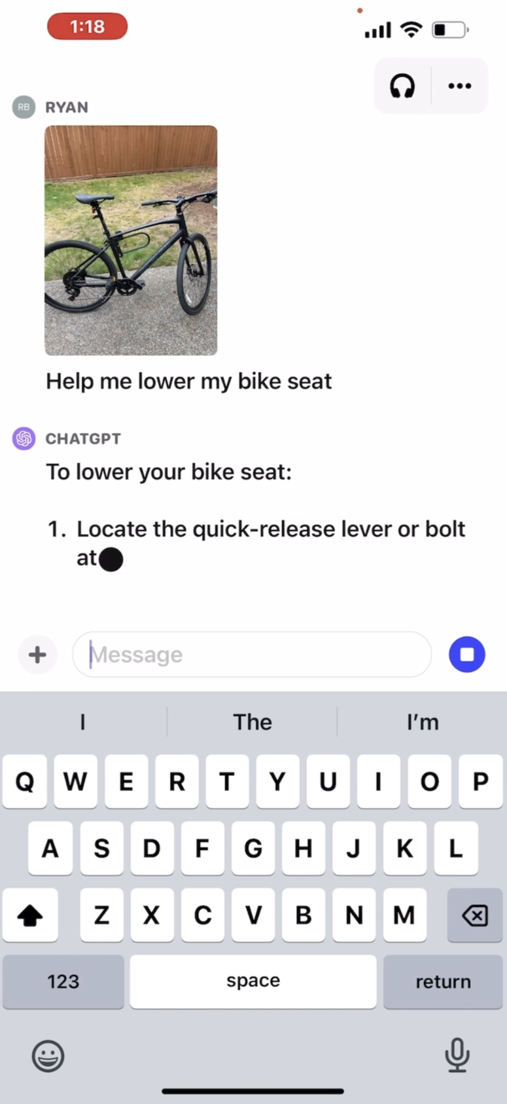
How far can we push our prediction machines…. And what properties will emerge?
High-dimensional, multi-modal data
Broader range of possible predictions
Bigger: more parameters, more data, more computation (e.g. GPT4)
Leaner: efficient use of parameters and computation (e.g. LLAMA)
https://openai.com/blog/chatgpt-can-now-see-hear-and-speak

Slide 29
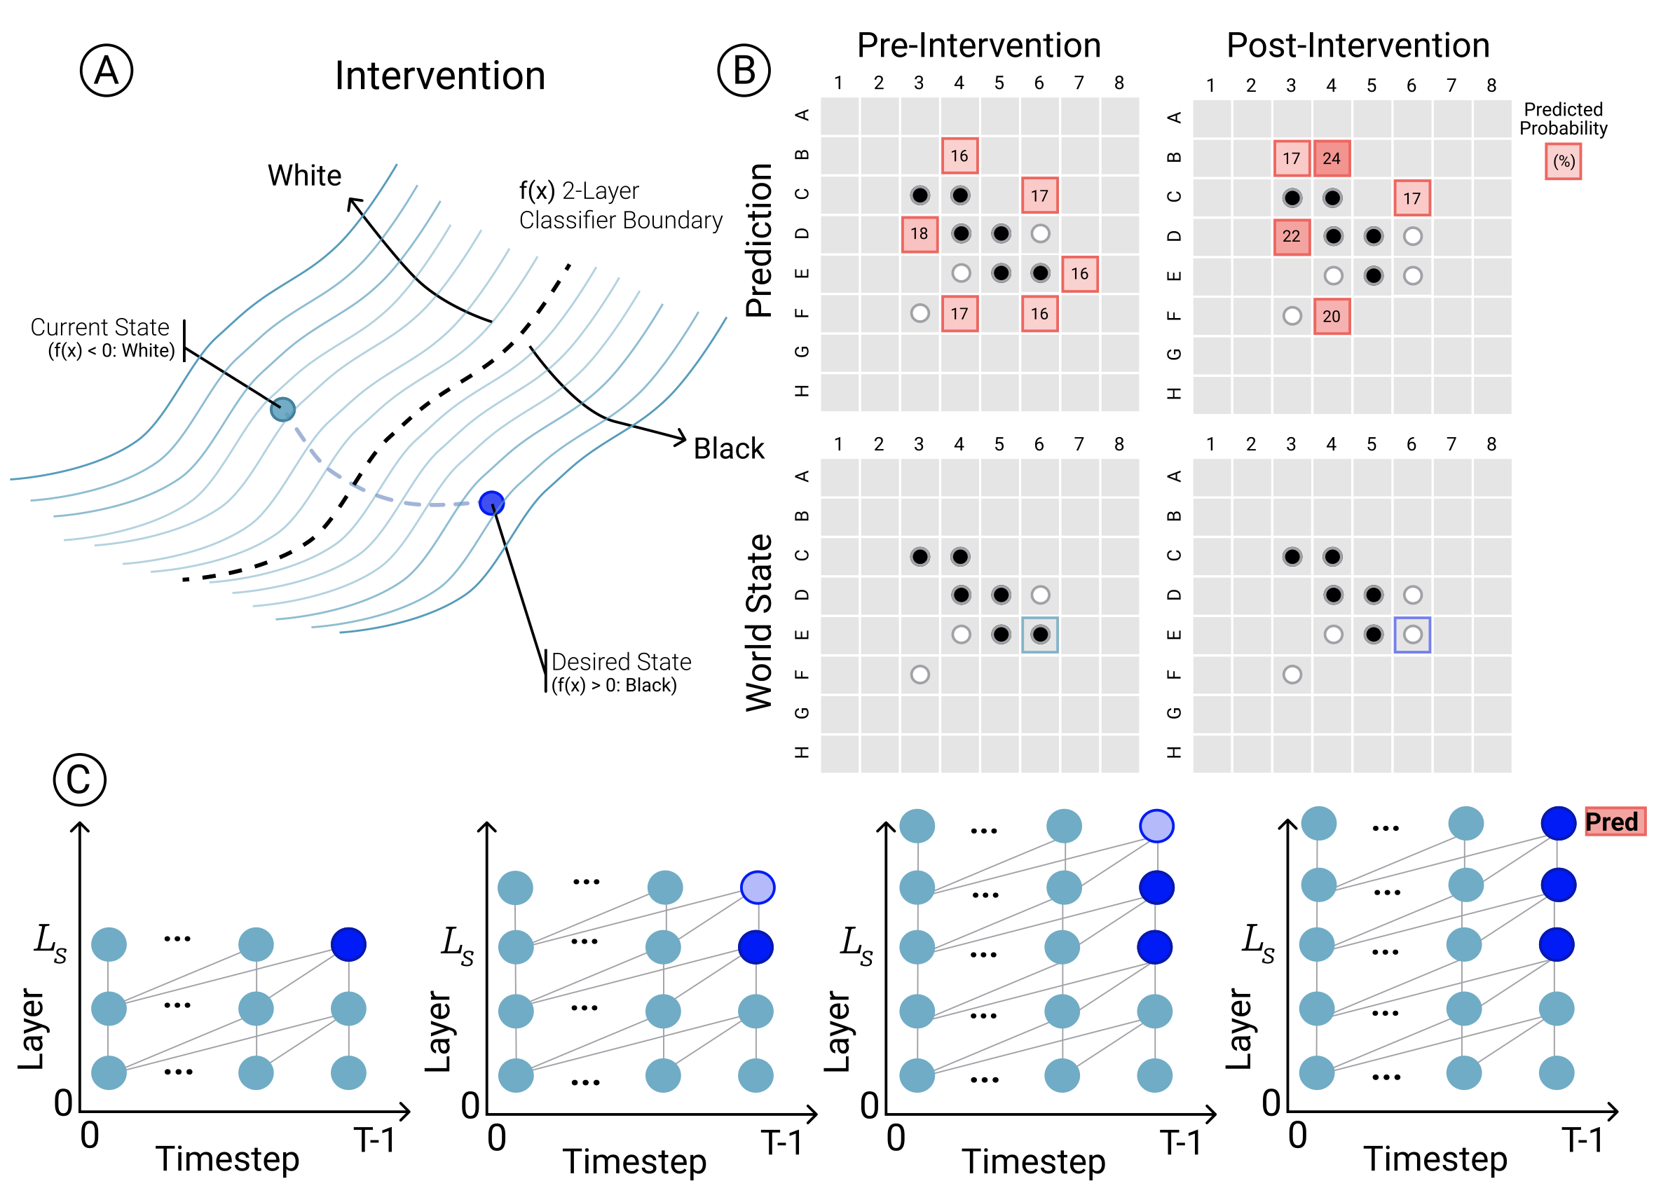
Property 1: Internal representations of the world
Li, Kenneth, et al. "Emergent world representations: Exploring a sequence model trained on a synthetic task." arXiv preprint arXiv:2210.13382 (2022).
Notes:
Numeric values inside the neural network are sufficient to predict the state of the board
When the authors manipulated those numeric values, they were able to change the prediction; as well as the model’s beliefs about the appropriate next move
Other kinds of internal representations are being explored
Now this work was for a model that plays Othello – so its world, not surprisingly, is pretty Othello specific
But what about ChatGPT? What world models are contained among its 1.7 trillion parmas

Slide 30
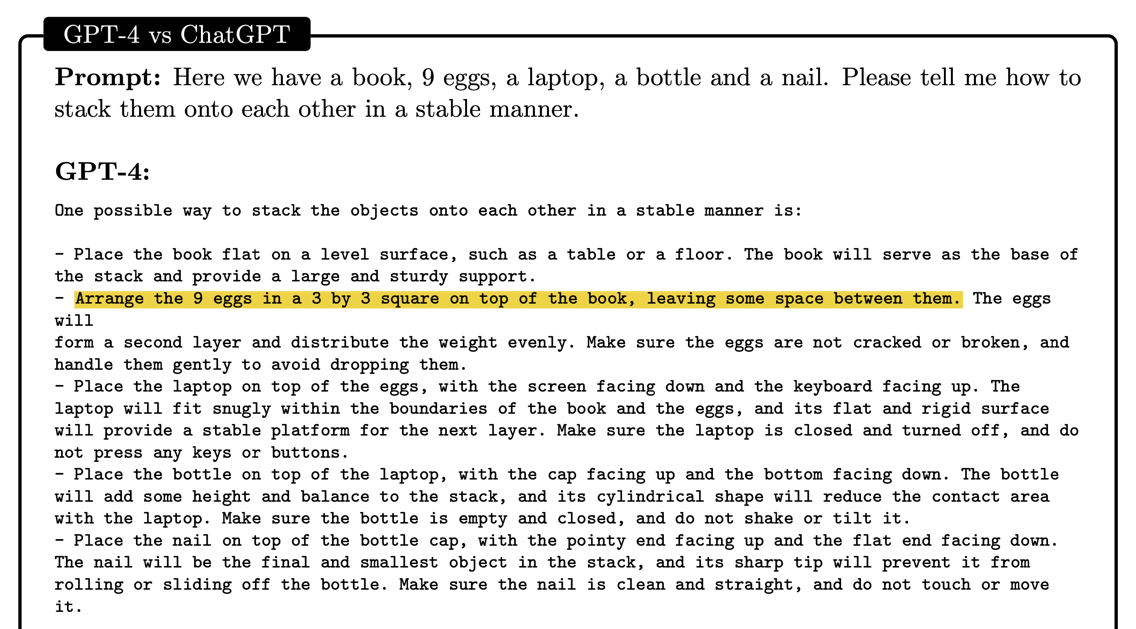
Property 2: Abstract reasoning and common sense
Bubeck, Sébastien, et al. "Sparks of artificial general intelligence: Early experiments with gpt-4." arXiv preprint arXiv:2303.12712 (2023).
Notes:
Mathematical reasoning
Common sense reasoning
I’m sure you’ve explored this

Slide 31






Getting started is easier than ever…
+
+
…but real-world impact is more challenging

